Slide 1
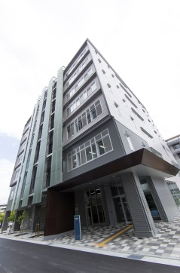
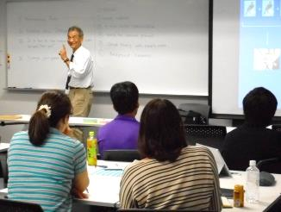
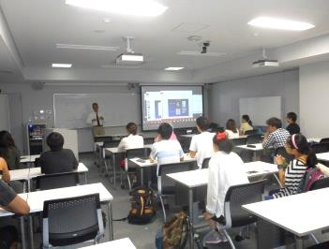
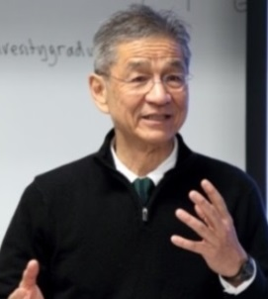
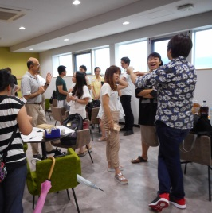
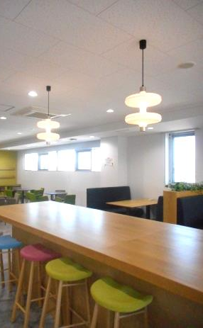
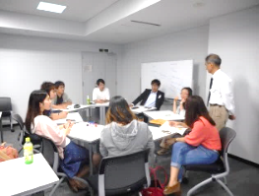
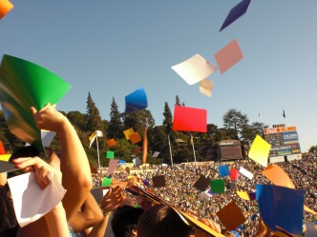
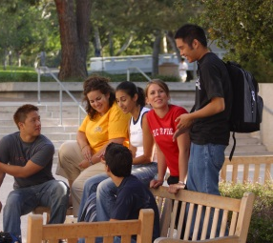
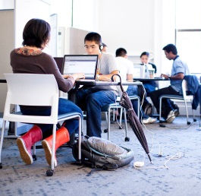
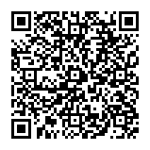
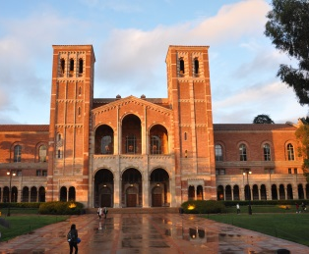



CASE BASED CRITICAL THINKING SPECIAL LECTURE No.19
UC OSAKA OFFICE
This Month’s Discussion Topic:
10/3
Seminar
Drugs in Sports:
Was Banning Russia from
the Olympics Fair?
Interactive Seminar Brainstorming & Creative Discussion in English Led by Professor John Ino Professor Emeritus,
University of California San Francisco
The Olympic Games was held this summer in Rio de Janeiro. Relating to the Olympics, this month’s seminar will discuss the various matters critically such as revealed doping issues, what doping is, the fairness of the decision made to Russian athletes, and so on. Please join us!
seminar
UC OSAKA OFFICE ★ UNIVERSITY OF CALIFORNIA OSAKA OFFICE ★ UC OSAKA OFFICE ★ UNIVERSITY OF CALIFORNIA OSAKA OFFICE ★
Monday, October 3 1：30pm～4:40pm
Where: 7F Lecture Room, Interdisciplinary Research Building
Toyonaka Campus
Open to: All Osaka University students
Contact: UC Osaka Office for any enquiries
Tel: 06-6850-6785
Email: kyosui-gakusei-uceap@office.osaka-u.ac.jp
Entry: Online booking essential (first come, first served).
Online booking is available here: http://osku.jp/r029
Deadline: Friday 30 September, 12:00 noon
Materials for the seminar can be found here:
<http://www.inosensei.com/osakauniversitygraduate/index.html>
UC/UCEAP大阪オフィスFacebookページ
https://www.facebook.com/UC.UCEAP.Osaka
UC Osaka Office Special Lecture：This special English lecture series is being conducted in an interactive seminar-style, based on group discussions about familiar topics. Participants consider things from multiple viewpoints, critically and pleasantly, through stakeholder analysis in order to develop logical thinking ability and communication skills.
Is this your first time to join the lecture? Don’t worry! You are welcomed!

