Slide 1
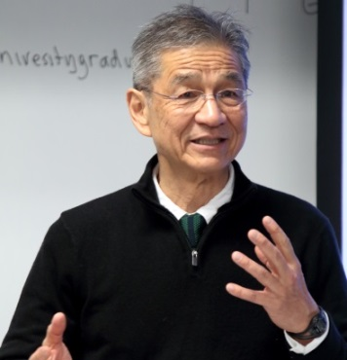




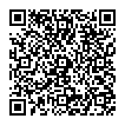

CASE BASED CRITICAL THINKING SPECIAL LECTURE No.12
UC OSAKA OFFICE
Designing Your Family: Do You Want a Boy or Girl?
近年、医療の進歩によって、男女の産み分けも可能な時代となりました。医療技術の進歩とともに浮かび上がる様々な問題について、あなたならどう考えますか。
Let’s discuss in English!
Interactive Seminar Brainstorming & Creative Discussion in English Led by Professor John Ino Professor Emeritus,
University of California San Francisco
In recent years, gender selection has been made possible by the progress in medical technologies. There are many things to be discussed considering the current medical technologies.
What are your opinions? Let’s discuss it!
Thursday, March 17
1：30pm - 4:40pm
Where: 6F Lecture Room, Interdisciplinary Research Building
Toyonaka Campus
Open to: All Osaka University students
Contact: UC Osaka Office for any enquiries
Tel: 06-6850-6785
Email: kyosui-gakusei-uceap@office.osaka-u.ac.jp
Entry: Online booking essential (first come, first served).
Online booking is available here: http://osku.jp/a000
Deadline: Tuesday 15 March
Reading materials can be found here:
http://www.inosensei.com/osakauniversitygraduate/index.html
UC/UCEAP大阪オフィスFacebookページhttps://www.facebook.com/UC.UCEAP.Osaka

