Slide 1

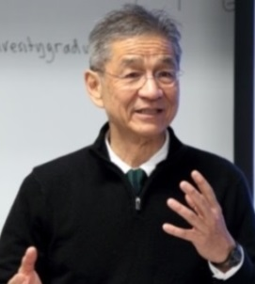
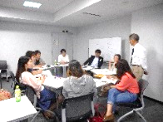


CASE BASED CRITICAL THINKING SPECIAL LECTURE No.42
by UC OSAKA OFFICE
WATCH
INO-SENSEI ON YOUTUBE !
https://www.youtube.com/watch?v=CdklRRqaSpA
This Month’s Discussion Topic:
Should The Government
Tax Coke?
Please check here for more details:
http://www.inosensei.com/osakauniversitygraduate/index.html
Interactive Seminar
Brainstorming & Creative
Discussion in English Led by Professor
John Ino
This lecture
aims to give students a chance
to discuss familiar and important topics with people
with different background. You will learn various
perspectives of people from different departments,
studies, and nationalities. Please join us!
John Hampton Ino:
Professor Emeritus,
University of California,
San Francisco
★ UC OSAKA OFFICE ★ UNIVERSITY OF CALIFORNIA OSAKA OFFICE ★ UC OSAKA OFFICE ★
Date: Tuesday 6 November, 1:00pm – 4:10pm
Where: Lecture Room 4, Interdisciplinary Research Building 7F,
Toyonaka Campus
Open to: All Osaka University students
Contact: UC Osaka Office for any enquiries
Tel: 06-6850-6785 / Email: uceap@office.osaka-u.ac.jp
Entry: Please send an email with Subject “11/6 UC Seminar Booking”
including the following criteria by 9 AM, Friday, 2 November.
You can join us on the day if there might be space after the deadline,
please don’t hesitate to contact us.
1. First name, FAMILY NAME 2. Your nationality 3. Student ID number 4. Dept./School/Lab name etc and year of study (i.e. School of Dentistry U4) 5. Your phone number 6. the number of times you have attended this seminar so far. 7. Any messages if you have.
☆Topic and Materials for the seminar can be found here:
http://www.inosensei.com/osakauniversitygraduate/index.html
Let’s enjoy discussion!
UC/UCEAP大阪オフィスFacebookページ https://www.facebook.com/UC.UCEAP.Osaka/

