Slide 1
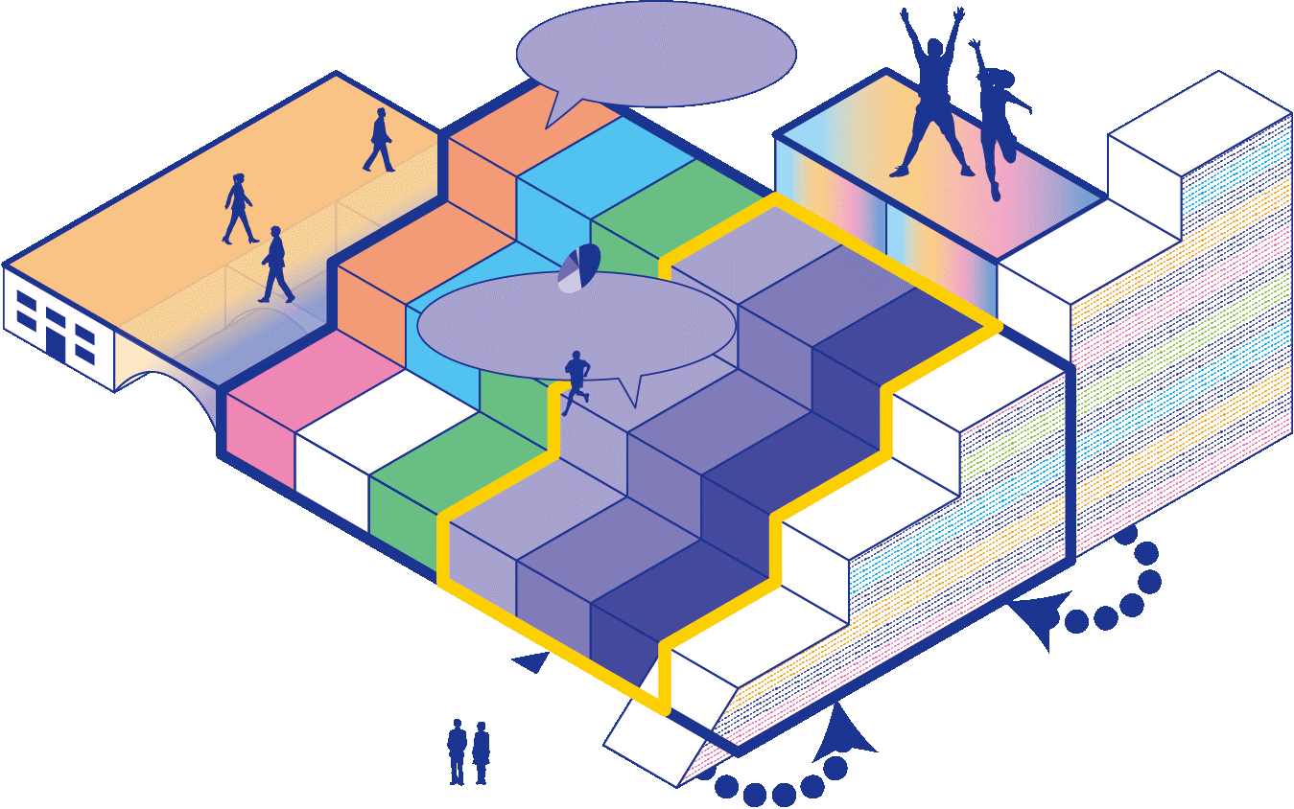



Enrichment of educational environment in which diverse students gather
from around the world
doctor
International collaboration
Internship on Campus
Integration of Knowledge with Society
master
Fusion of Knowledge
Enhance specialization
Integration of Knowledge with Society
Recurrent education with mutual benefit for companies and the university
Double Degree
Program
Promote interdisciplinary fusion
Resolve
societal issues
Strengthening of mathematics and data science education
Strengthening of health
and sport science
Double-Wing
Academic
Architecture
bachelor
Core Expertise
Undergraduate
English Course
Promotion of
blended education
Overall
optimization
Student Life-Cycle
Support
Liberal
Arts
Academic Major
Global Literacy
Admission
High school/university connection

